Slide 1
24MAT120
S2 P & M

Slide 2
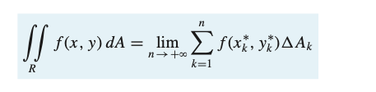
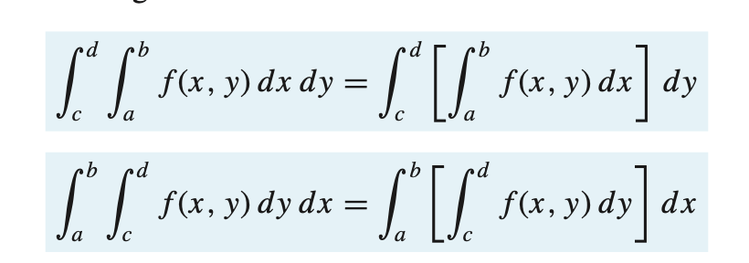

Slide 3
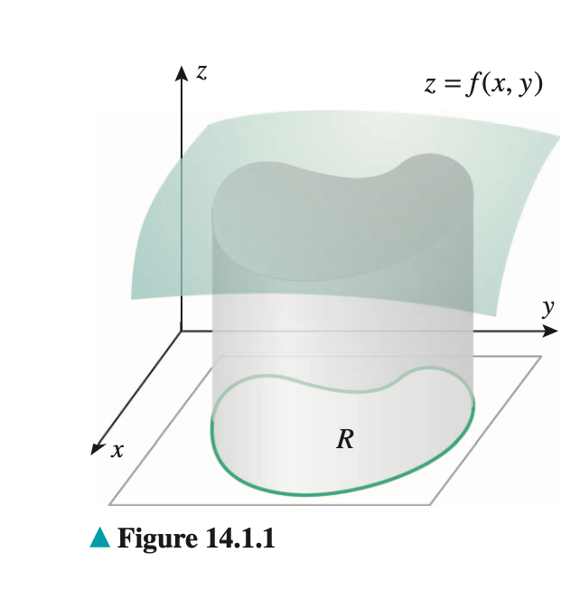
Double Integrals as Volumes
Given a function f of two variables that is continuous and nonnegative on a region R in the xy-plane, find the volume of the solid enclosed between the surface z = f(x, y) and the region R.

Slide 4
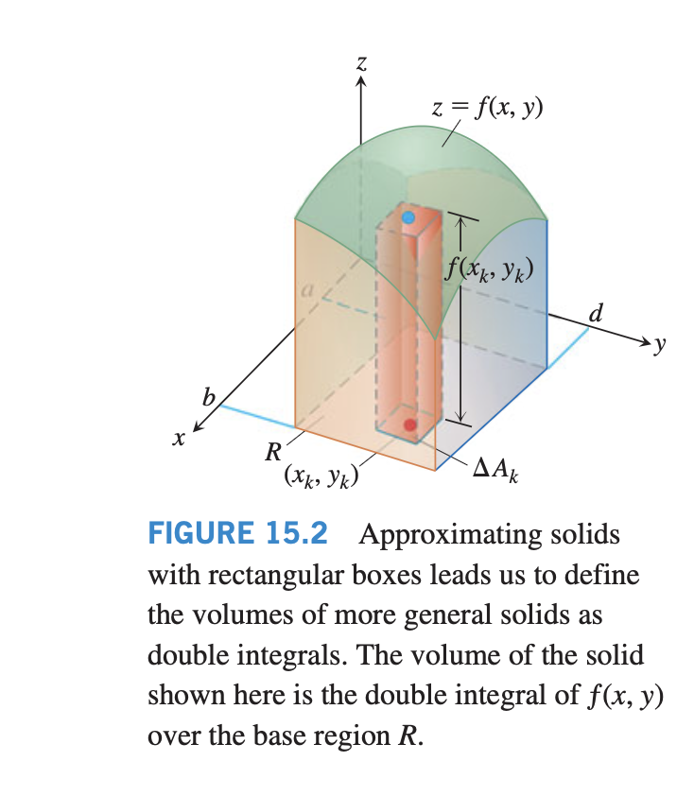
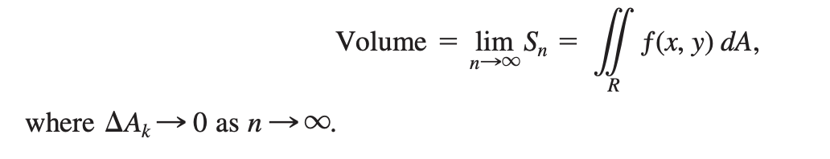
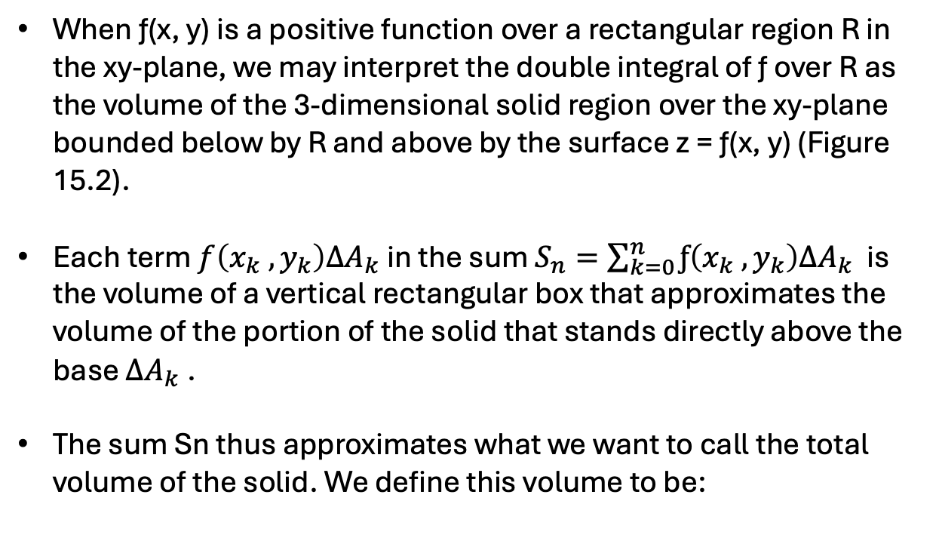
When ƒ(x, y) is a positive function over a rectangular region R in the xy-plane, we may interpret the double integral of ƒ over R as the volume of the 3-dimensional solid region over the xy-plane bounded below by R and above by the surface z = ƒ(x, y) (Figure 15.2).
Each term $f\left(x_{k} , y_{k}\right)∆A_{k}$in the sum $S_{n}=\sum_{k=0}^{n}{ƒ\left(x_{k} , y_{k}\right)∆A_{k}}$is the volume of a vertical rectangular box that approximates the volume of the portion of the solid that stands directly above the base $∆A_{k}$.
The sum Sn thus approximates what we want to call the total volume of the solid. We define this volume to be:

Slide 5
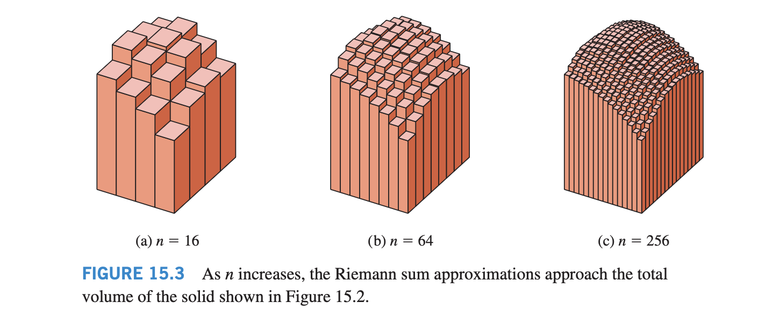

Slide 6
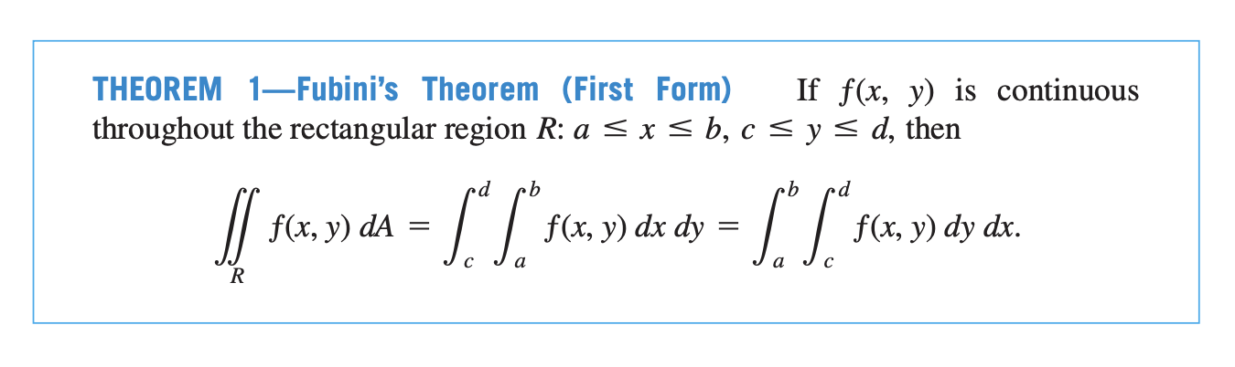
Fubini’s Theorem for Calculating Double Integrals

Slide 7
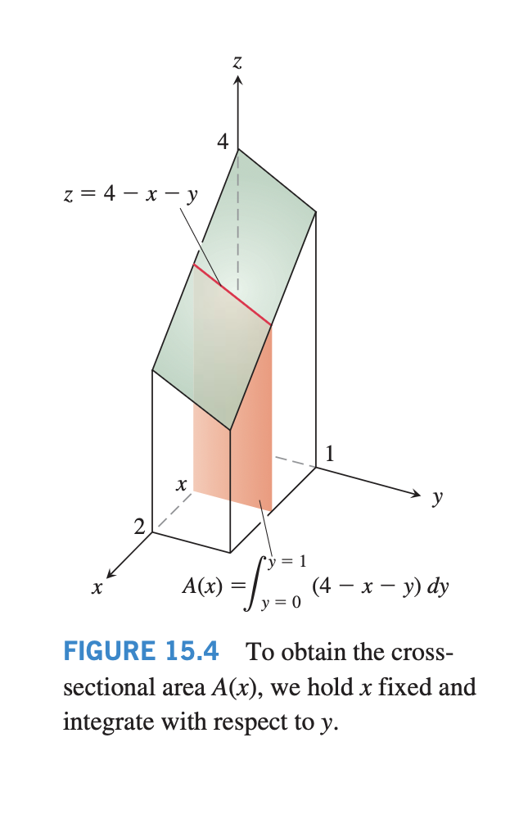
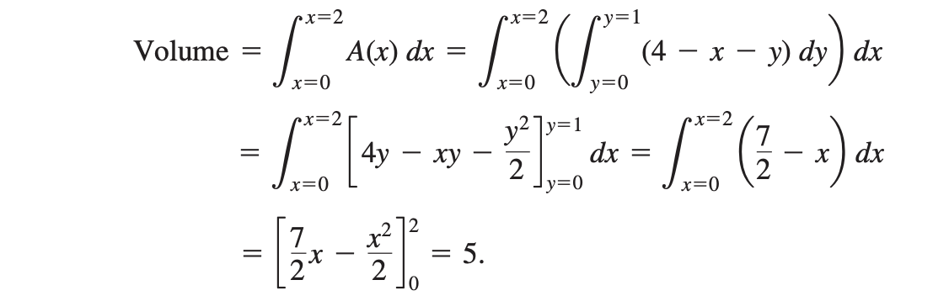

Slide 8
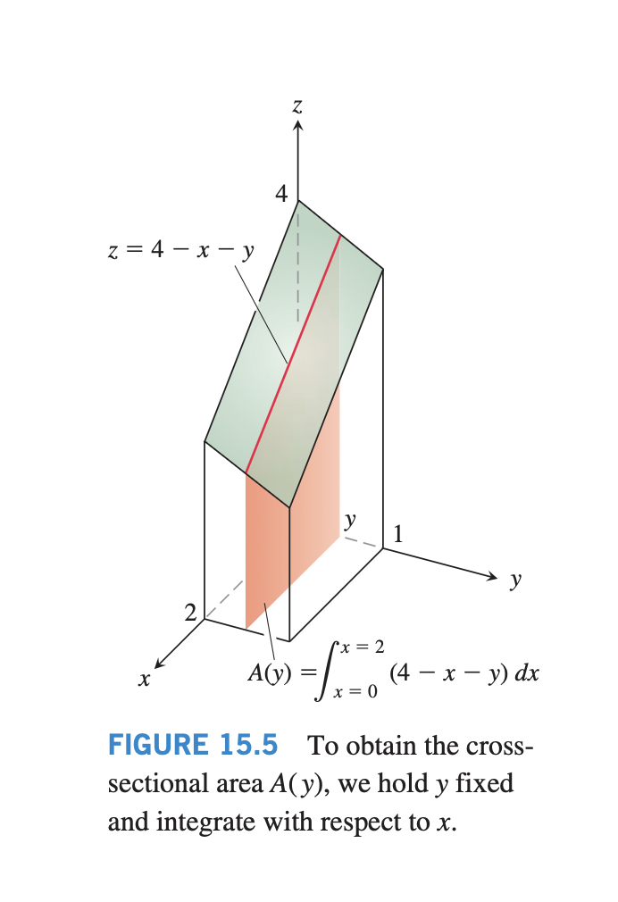
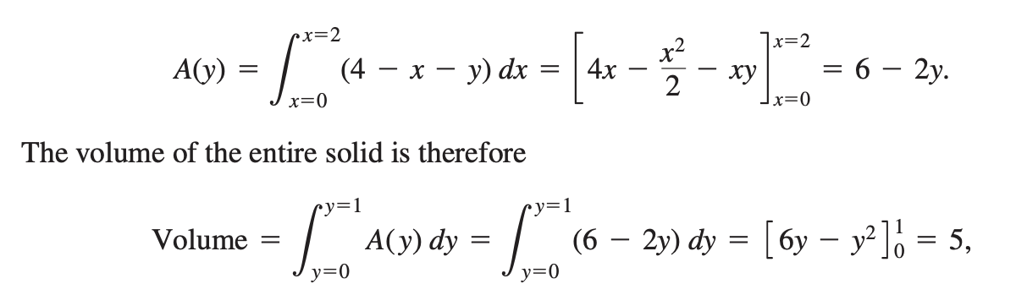

Slide 10
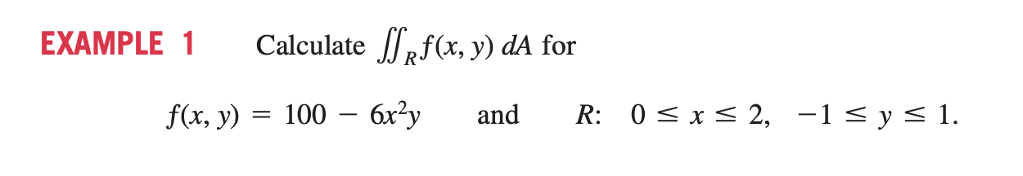
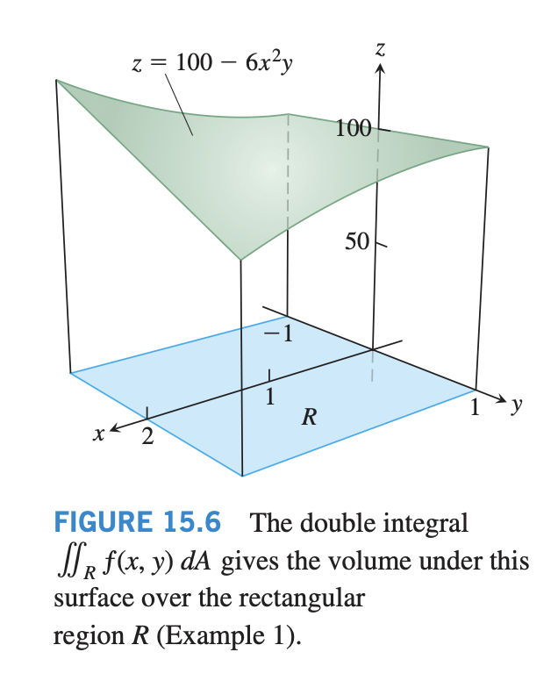
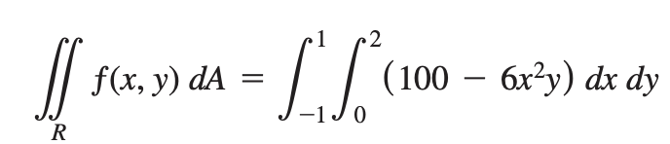
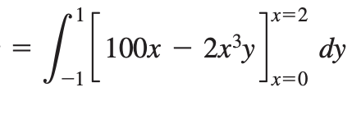
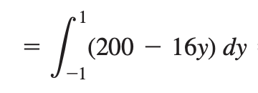
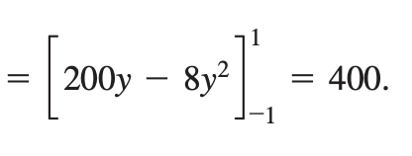

Slide 11
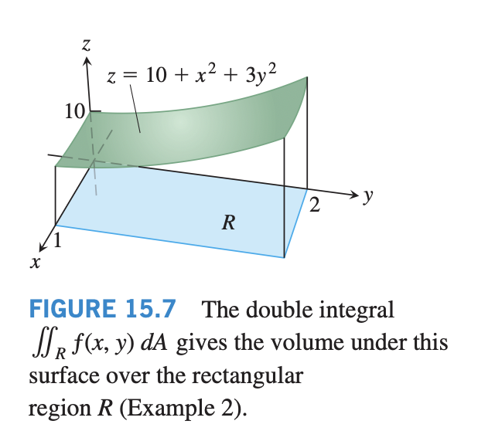
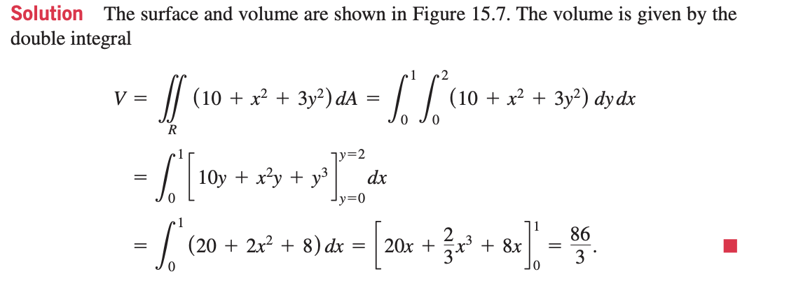

Slide 12
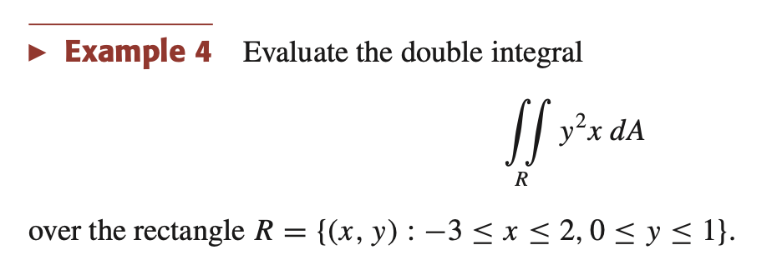
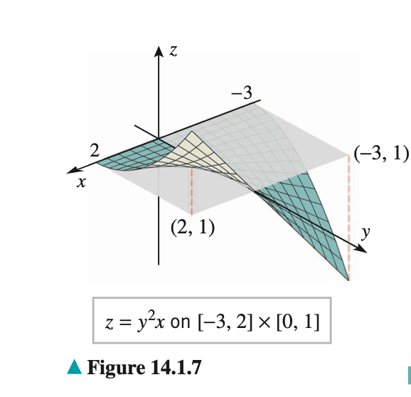
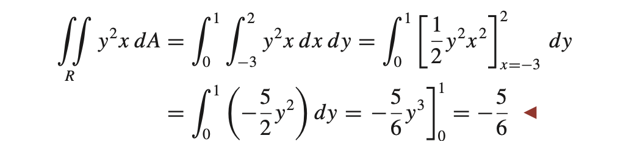

Slide 13
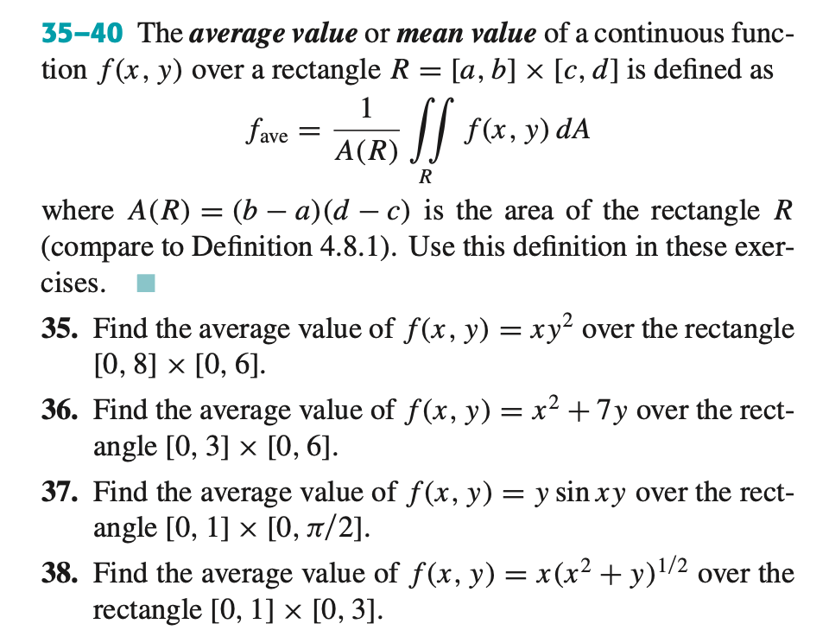

Slide 14
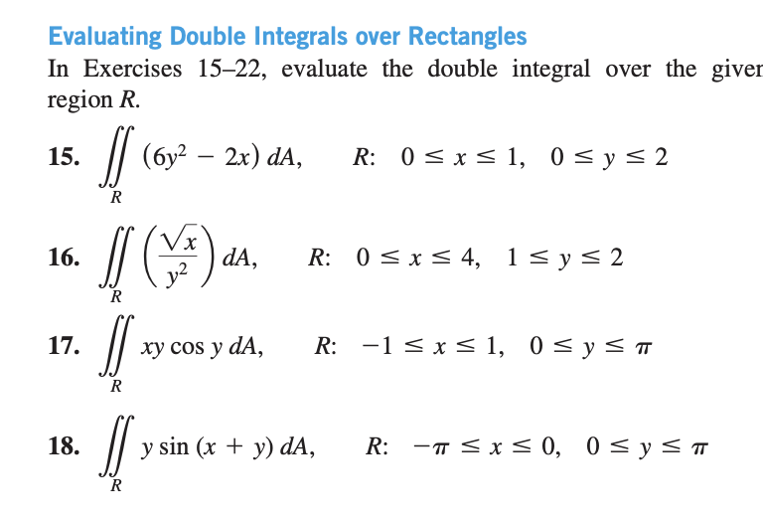

Slide 15
